Slide 1
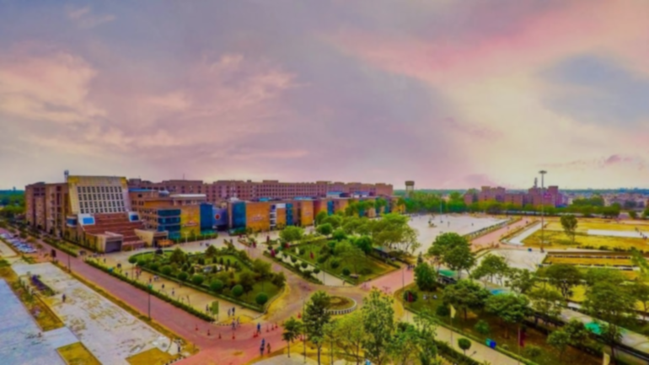


IT Infrastructure @
L
OVELY
P
ROFESSIONAL
U
NIVERSITY

Slide 2
Features of IT Infrastructure
The backbone of transforming the education system at LPU
Improve communication and enhance efficiencies and productivity
IT infrastructure is flexible, reliable, and secure

Slide 3

Improve communication, create efficiencies and increase productivity.
Components of IT Infrastructure
Hardware
Networking
The backbone of transforming the education system at LPU
Software
IT infrastructure is flexible, reliable, and secure

Slide 4

1
Datacenter
Servers
2
3
Storages
Hardware
Routers
4
5
Switches
Facilities
6
7
Computers

Slide 5
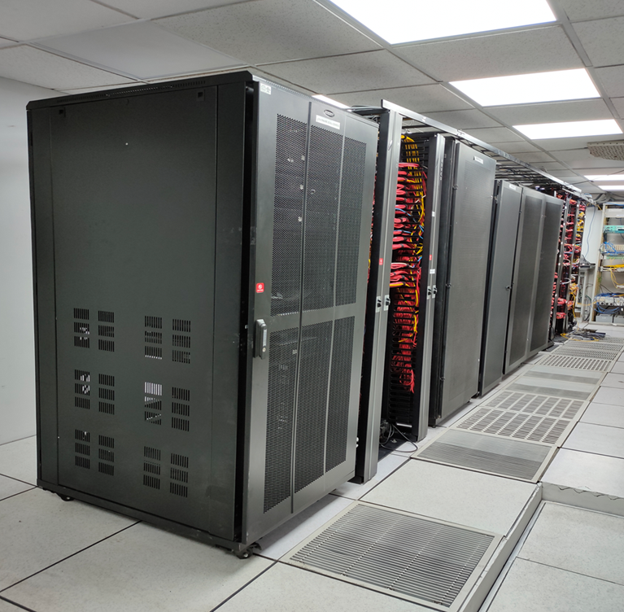
LPU’s Datacenters
1
All the devices are deployed and are given proper environment for smooth working of network operations.
2
All the data convergence policies such as routing / switching & also computing services are managed.
3
The university datacentre works 24x7 to provide internet and intranet services.
4
All the passive infrastructure, designed in star topology is connected to this point.

Slide 6
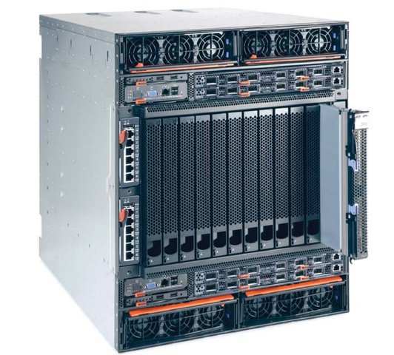
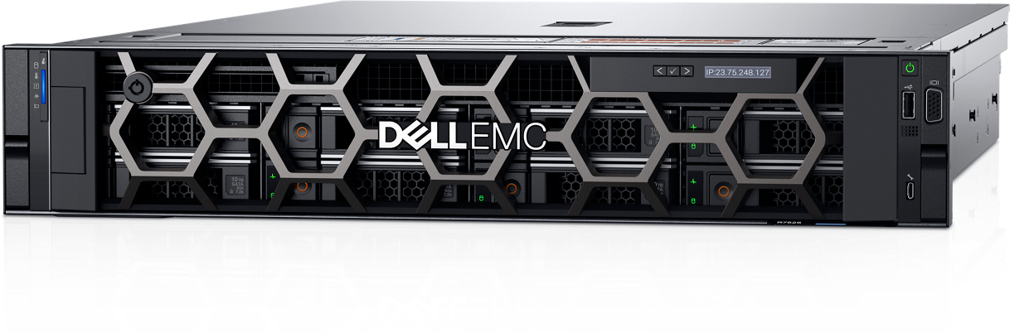

Servers
Datacenter has 55+ high end servers of brands like IBM/HP/DELL/LENOVO.
They mainly cater Server-side applications, as per requirement using both Physical as well as Virtual infra (VMWARE /HYPER-V) technologies for better optimization of servers.
BLADE SERVER
Server Specifications:
64/32/16 Cores,
144GB/128GB ECC RAM / RPS, and
latest SSD/SAS Drives.
All the server hardware is equipped with Redundant components / Resiliency features like RAID and Hot swapping features to provide maximum uptime / Scalability.
RACK-MOUNT SERVER
TOWER SERVER

Slide 7
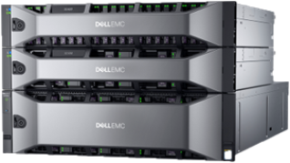
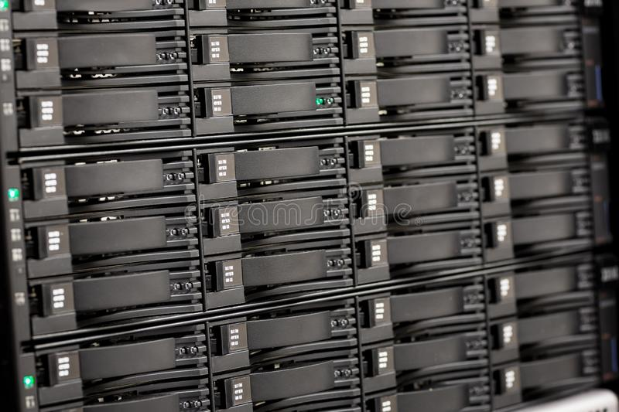
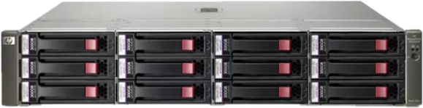
SAN Storage
380 TB
2000 TB
DELL EMC FC SAN
NAS
Network Attached Storage
Fibre / SAS Channel-based External SAN Storage from Multivendor like IBM /HPE/ DELL EMC is being deployed for overall data services in LPU.
LPU’s SAN Storage can also be scaled up to 2 Petabytes
IBM SAS SAN
For D2D scheduled critical data backup for Database / File level data
HP FC SAN

Slide 8
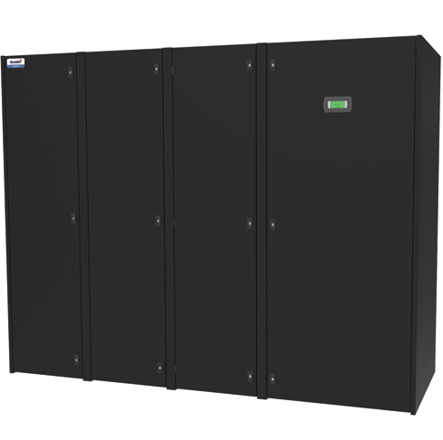
Facilities
Precision Air Conditioners (PACs)
6.5 TR
The datacenter is equipped with Precision Air Conditioners (PACs), to ensure the devices at the datacenter remain working 24x7 and provide maximum uptime.

Slide 9
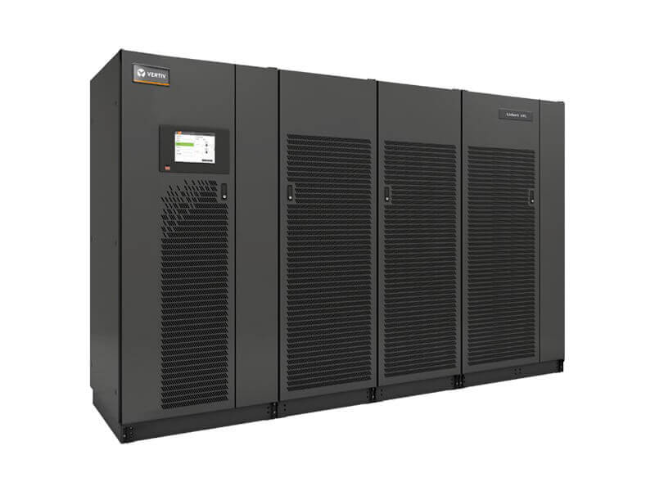
Facilities
Uninterrupted Power Supplies (UPS)
1000 KVA
The university has a distributed backup of up to 1000 KVA (UPS) to support all devices.
The data center is backed up by dedicated UPSs installed in parallel mode to provide maximum resiliency power and voltage fluctuations.

Slide 10
Improve communication, create efficiencies and increase productivity.
Components of IT Infrastructure
Hardware
Networking
The backbone of transforming the education system at LPU
Software
IT infrastructure is flexible, reliable, and secure

Slide 11
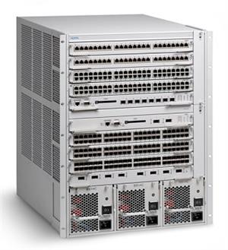
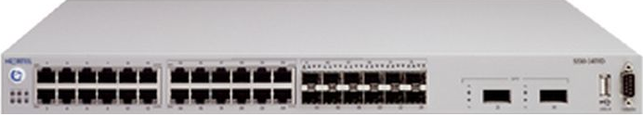
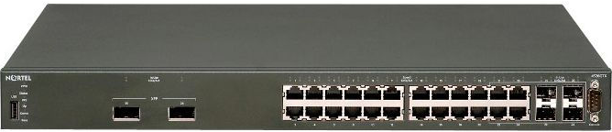

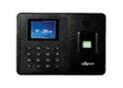

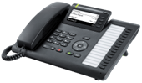
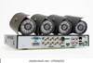

Networking
LPU Network 3 Tier Architecture
Nortel 8600 Core Switch
The flow of network originates from Centre point i.e., core switch, moves to distribution , access layer and vice a versa .
10G OPTICAL FIBER connectivity
CORE LAYER
This 3-tier architecture reduces the load on core switch and allows better network convergence.
Nortel 5500 Main Distribution
DISTRIBUTION LAYER
1G connectivity Optical FIBER/CAT6
At access layer a total of 350 (POE/NON-POE ) switches are deployed to cater network requirements at different location spanning across the campus.
Nortel /CISCO/HP/ARUBA
ACCESS LAYER
POE / NON-POE Switches

Slide 12
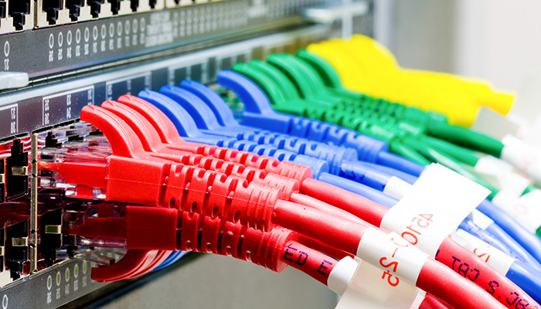
Optical Fiber & UTP Cabling
The university has strong optical fiber uplink connectivity acting as a backbone of the network.
Single mode and Multimode optical fiber have been laid to provide network connectivity to each building in an isolated manner.
Typically, star topology is followed in the network scenario.

Slide 13

Optical Fiber & UTP Cabling
70+ KM
underground optical fiber has been laid at the campus.
Many of the LAN points are working at 1.8 Gbps on CAT6 cables.
1.8 GBPS

Slide 14





INTERNET LEASE LINE
5 GBPS
The university is using a total of 5 Gbps bandwidth to cater to IT-related requirements.
Currently, the major chunk is with Connect telecom and NETPLUS

Slide 15
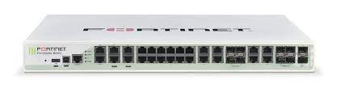
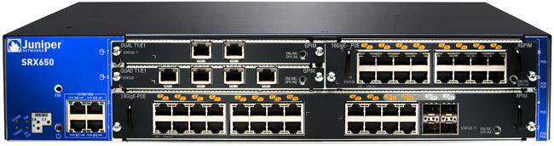
Wireless Network Infrastructure
The university has deployed around 2000 wireless access points to cover the whole campus on Wi-Fi.
Datacenter’s wireless LAN controllers control these access points.
LPU has been chosen as an Experience Centre by Reliance Jio to deploy the largest mobile network for additional Wi-Fi Services on the campus with 1 GB for each user per day.

Slide 16
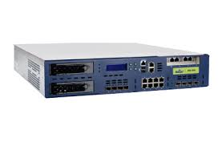
Firewall
SERVER-1
SERVER-2
Juniper Firewall
deployed at the gateway level to prevent unwanted traffic from hitting the LPU network scenario.
Fortinet Firewall
works for all the NAT IP, VPN connections, IP policy routes, internet access scheduler, and port forwarding.
also acts as a load balancer to pass the network traffic for bandwidth management solution.
RADIUS SERVER
Juniper Firewall
SERVER-3
USER DATABASE SERVERS
Fortinet Firewall
SERVER-4

Slide 17
Bandwidth Management
SERVER-1
1
Preventing the misuse of bandwidth.
RADIUS SERVER
SERVER-2
2
12000 Concurrent sessions.
USER DATABASE SERVERS
SERVER-3
3
SERVER-4
Catering Dynamic Requirements.

Slide 18
Improve communication, create efficiencies and increase productivity.
Components of IT Infrastructure
Hardware
Networking
The backbone of transforming the education system at LPU
Software
IT infrastructure is flexible, reliable, and secure

Slide 19
New software and databases subscription purchased to fulfil academic requirements.
Around 40 software purchased in last 4 years including Microsoft DreamSpark, Proteus-VSM for Labs, Adobe creative clouds, etc.
Software

Slide 20
List of Available Software and Applications
Microsoft Dream Spark Premium Purchase
Proteus VSM for Labs
JQWedgets License
Mail Merge Toolkit
Flip PDF
Adobe Creative Cloud for Labs
Zerobounce
Libsys
Send Grid Mail
Office 365 Education Services for faculty and students
Office 365 Education Power Bi Service
Office 365 Project Services
Plaxis 2D suite
PRO VSM
Tutnitin
Animal Simulator Software
dspace
CADENCE Tools
COMSOL Multiphysics
WSGN for Labs
FL Studio
Cubase 9.5 for Labs
Adobe Creative Cloud for Labs
QuarkXPress 2018
Magix Vegas Pro 15 ESD Academic
Corel DRAW Graphics Suite
Optisim
VMware Academics for Labs
EBOX
ezProxy
TCAD
SAP ERP
Mcafee
Bentley
Creo for Labs
MATLAB
REACH CAD
Google Mail Services
SMS Messaging Server

Slide 21

IT Facilities
Surveillance
Access Control
Announcement System
Sound & Projection

Slide 22
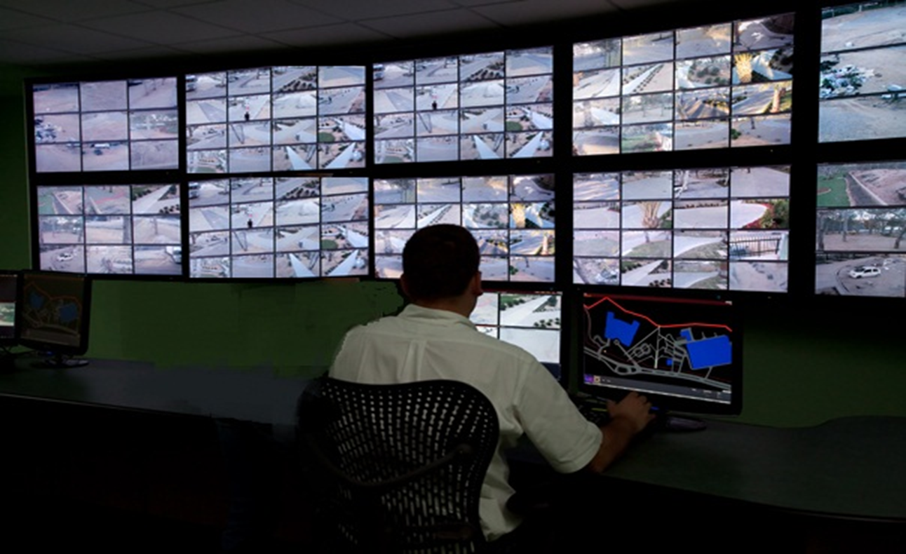
5 Comments on one Picture
Surveillance
7400+ CCTV cameras put across the University
Based on the HIKVISION, DVTEL, and LG platforms, one of the best in the world
System can be accessed from anywhere in the world
Recording capability to 7 to 15 days
A dedicated team is handling the installation & maintenance of CCTV cameras.

Slide 23
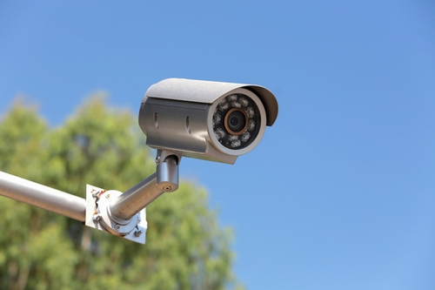
Features of CCTV Cameras Available @ Campus
1
IP cameras
2
Remote Accessibility
3
True day night capability
4
Ensures sharp, accurate, and high-resolution video quality.

Slide 24
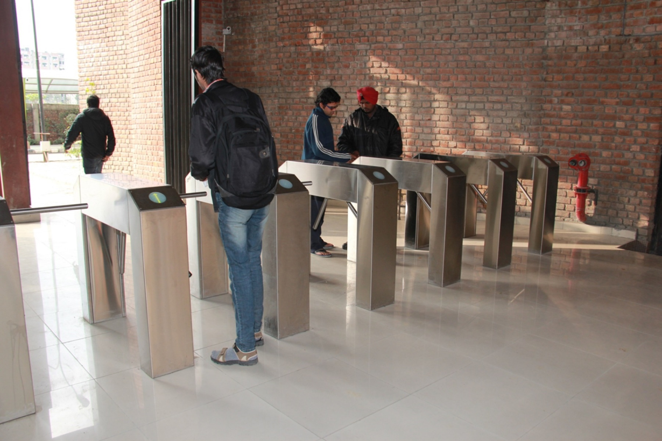
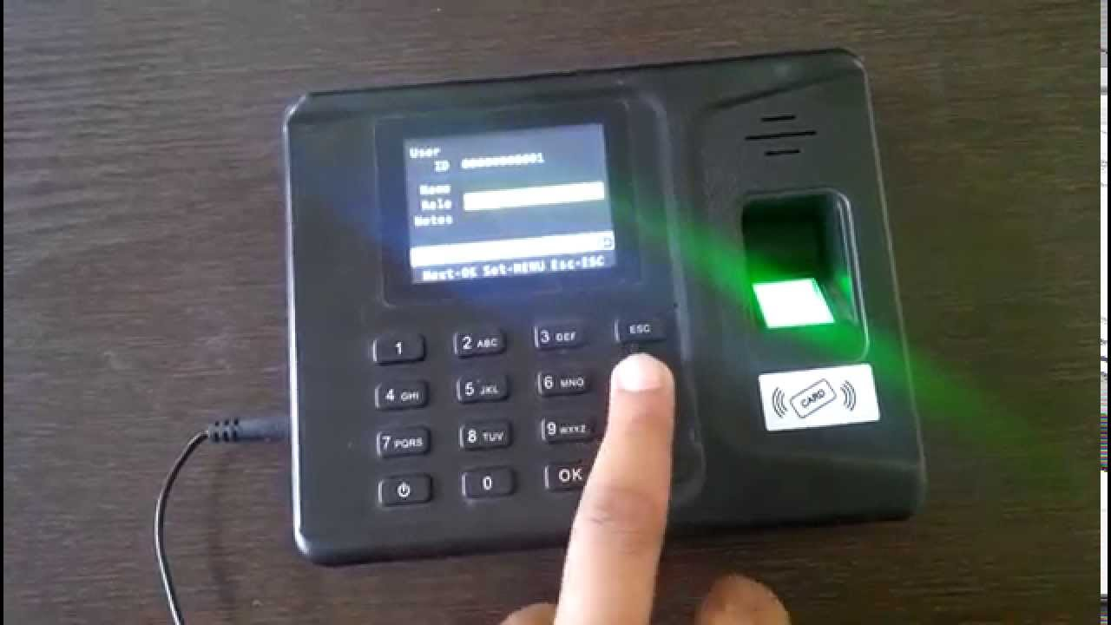
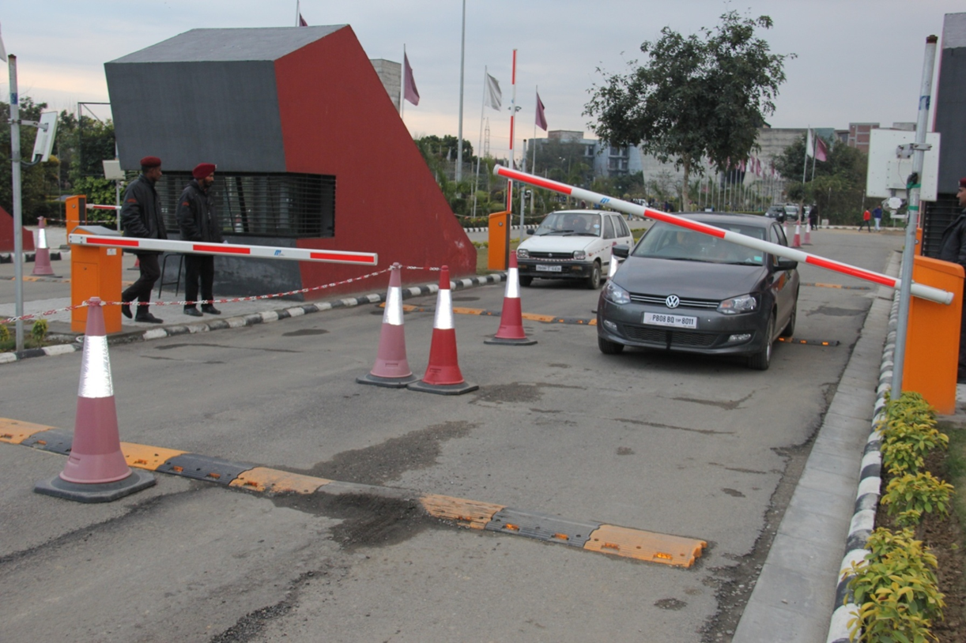
Announcement System
Sound & Projection
Access Control
Turnstile Gates
Biometric Machines
Boom Barriers with RFID

Slide 25
Highlights of Access Control System
Best in class world leader BOSCH SYSTEM installed for the Access Control.
WEB-BASED SYSTEM to control the system from anywhere.
More than 50 BOSCH controllers to control 160 devices/doors.
92 TURNSTILE GATES from world leader Kaba(German manufacturer) installed
16 BOOM BARRIERS (High Speed Toll Plaza Specification) from Magnetic (German)
200+ BIOMETRIC MACHINES from Suprema installed for Staff/student in/out logs

Slide 26

Features of Access Control System
Time based and location based access can be given
Controllers can store 2 lakhs transaction logs without network
More than 300 controllers can be attached to the system
More than 600 gates can be controlled
Emergency call possible from remote location
Integration with fire and CCTV
Integration with Elevators/Lifts interface possible

Slide 27
Massive Smart Card Distribution Exercise
More than 32000 SMART CARDS issued to students
More than 4000 SMART CARDS issued to University staff and vendors
3726 RFID cards issued for four-wheeler access

Slide 28
Use Cases
1
Control access of vehicles in the campus
2
Security access of visitors in hostel premises
3
Key access of sensitive areas
4
Automated hostel attendance
5
Tracking of student’s movement

Slide 29
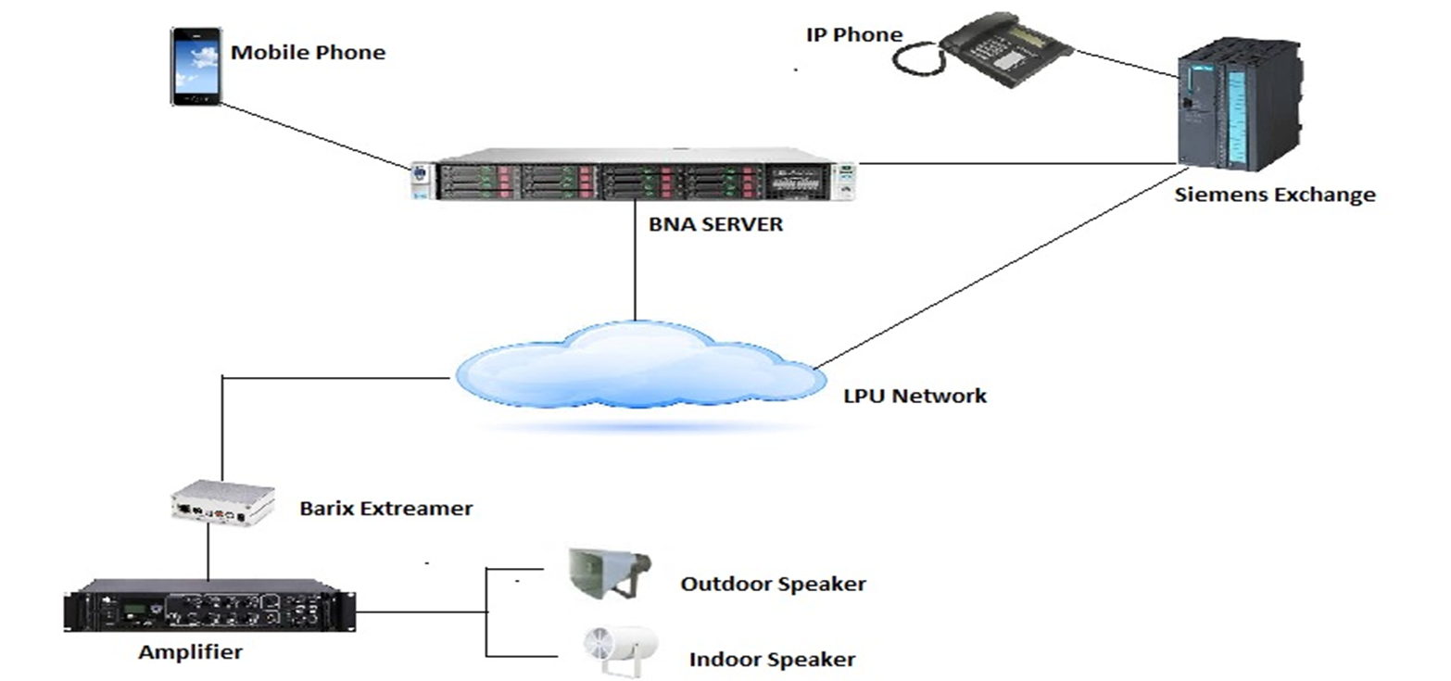
Public Announcement (PA) System

Slide 30
Highlights of the Public Announcement System
Cell Phone
4
1
Security Enhancement
Providing an interface with cell phone
Security Enhanced with PA System Installed across the campus including hostels, blocks, gates, and security vehicles.
IP phones
3
2
Centrally Connected
PA system connected with IP phones
PA systems are centrally connected

Slide 31
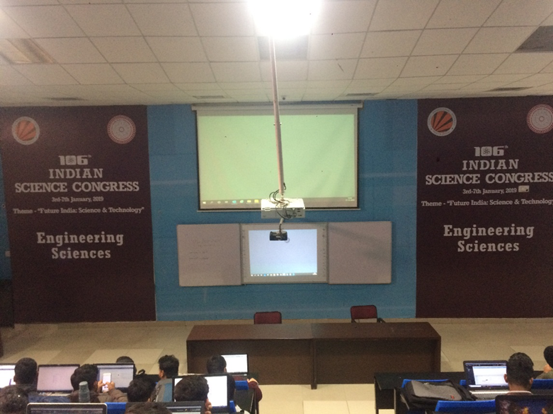
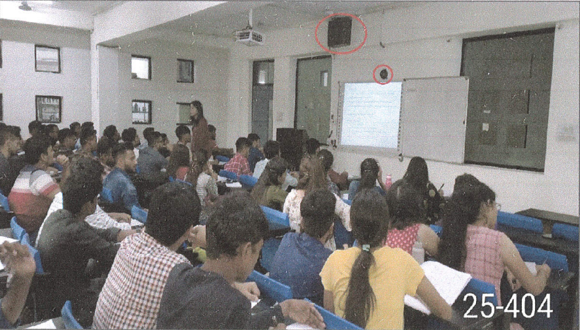
ICT Enabled Classrooms & Seminar Halls

Slide 32
ICT Facilities
Multimedia projectors are installed in the classrooms & Seminar halls.
Classrooms having CCTV cameras with recording facilities enable faculty members to see their recorded lectures and identify areas for self-improvement.
Seminar Halls are equipped with Microphones, Amplifiers, and speakers.
1400+
845
Smart Interactive whiteboards with finger touch installed in the classrooms & Seminar Halls.
60+
54

Slide 33

Thank You !!
Information and communications technology unlocks the value of time, allowing and enabling multi-tasking, multi-channels, multi-this and multi-that.
Li Ka-shing
founder of CK Hutchison Holdings

